Slide 1
Tactics for Influencing Executives and Middle Management - Leading Change
DevOps Enterprise Summit
November 8, 2016

Slide 2
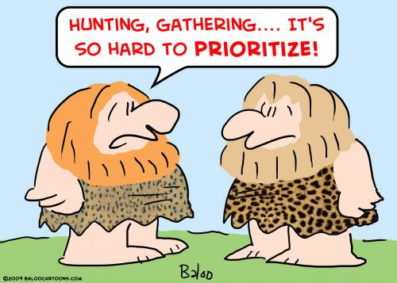




Executives care about....
https://s3.amazonaws.com/lowres.cartoonstock.com/history-caveman-neanderthal-hunt-hunter-hunting-rman9387_low.jpg
http://paccpronetwork.com/wp-content/uploads/2014/12/Small-Business-Goal-Setting.jpg
http://cdn2.hubspot.net/hub/78084/file-21369263-jpg/images/results_you_can_measure-resized-600.jpg
http://www.leadershipandchangemagazine.com/wp-content/uploads/2016/06/m_Happy-300x169.jpg
http://cdn2.hubspot.net/hub/185473/file-22534370-jpg/images/avoid_risk_from_itad.jpg

Slide 3


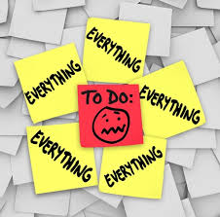


Issues the Executive encounters...
http://prize-performance.com/wp-content/uploads/2015/04/Price-Tag.jpg
http://4.bp.blogspot.com/-cWlUkbq74TY/UFPz4ALO0lI/AAAAAAAAZKk/6ij7sXwh9Yg/s640/meetingitisinside1.jpeg
http://3.bp.blogspot.com/-JPJJ3bFWjHw/VkEUntQp5WI/AAAAAAAADVQ/Vfkt7-16uB0/s1600/priorities.jpg
https://s-media-cache-ak0.pinimg.com/236x/ab/b2/c4/abb2c4d82d95723ec255f3cb377a3d1f.jpg
http://cdn.business2community.com/wp-content/uploads/2014/05/attract-talent.jpg

Slide 4

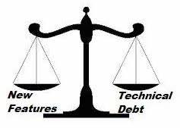

Middle Managers care about...
https://ga-core.s3.amazonaws.com/production/uploads/program/default_image/337/Technical-Recruiting-Techniques-To-Attract-Top-Talent.jpg
https://qph.ec.quoracdn.net/main-qimg-84eabe5c5c962ac7c45a131fb215bb06-c?convert_to_webp=true
http://cdn.moneycrashers.com/wp-content/uploads/2011/06/holding-hands-paper.jpg

Slide 5
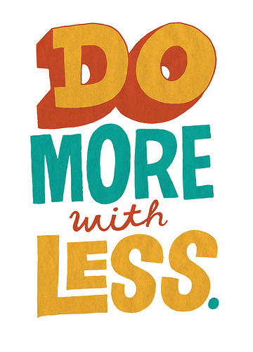

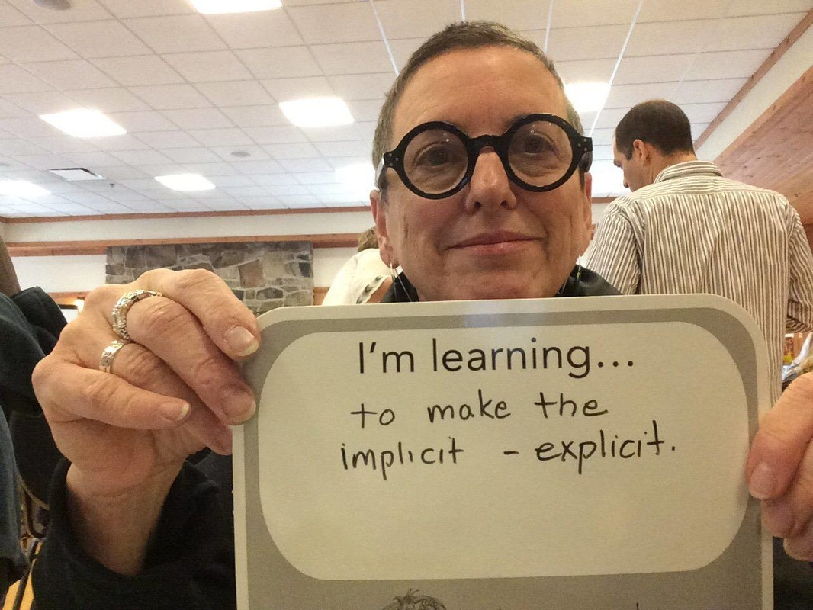
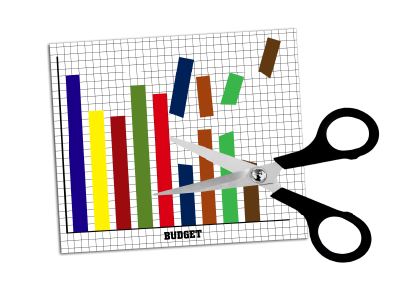

Issues the Middle Manager encounters...
http://www.digitalfilmacademy.edu/wp-content/uploads/2014/05/cut-costs.jpg
https://farm7.staticflickr.com/6216/6287794533_3c02abf913.jpg
http://vietstar-research.com/pic/Service/images/20.jpg
https://johnhalter.files.wordpress.com/2010/11/no-empowerment.png
http://www.jparadigm.org/uploads/7/0/0/9/70099615/4656762_orig.jpg

Slide 6

Target...
https://media.licdn.com/mpr/mpr/shrinknp_800_800/AAEAAQAAAAAAAAauAAAAJGMwNTg1NTI0LThjMTYtNGRjYS04M2I5LThmNzgyYjJmZmYzMw.jpg

Slide 7


From controlling change to
embracing change.
http://blogs.psychcentral.com/angst-anxiety/files/2013/03/controlling-relationships.jpg
http://cdn-media-1.lifehack.org/wp-content/files/2014/09/Embracing-change.jpg

Slide 8
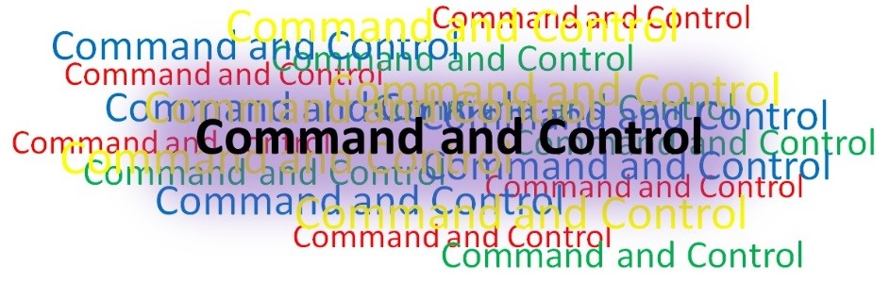

From command and control
to empowerment.
http://c2coe.org/wp-content/uploads/2015/01/Concept-C2-confusing-and-vague.jpg
https://www.fowcommunity.com/sites/default/files/redactor/women-empowerment-quotes-hd-wallpapers.jpg

Slide 9

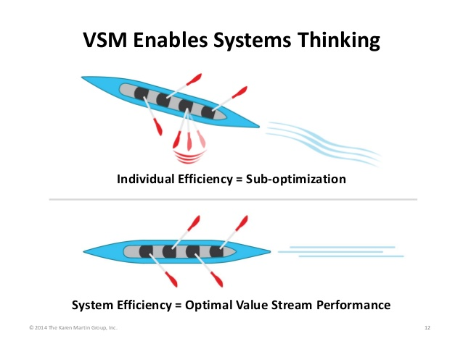
From functional silos to value
streams and systems thinking.
https://media.licdn.com/mpr/mpr/shrinknp_400_400/AAEAAQAAAAAAAAZHAAAAJDRmYmQwMjA0LTUyZjYtNGIzOC04NjM3LWEyODkyMDc4Y2RmNA.jpg
http://image.slidesharecdn.com/2014-01-28vsmwith5ssupply-140211122850-phpapp02/95/value-stream-mapping-what-to-do-before-you-dive-in-12-638.jpg?cb=1395410184

Slide 10


From low cost provider to
enabling business value.
http://2.bp.blogspot.com/-gWDVbQDQbN8/UYyUXBiUfxI/AAAAAAAAAHA/K3PkiC6B508/s1600/low-cost.png
http://www.htgpeergroups.com/wp-content/uploads/2016/05/istock_000016338626small_2_its_value.jpg

Slide 11


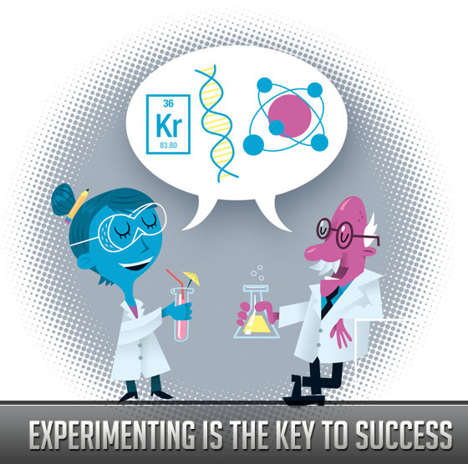
From hoarding resources to
sharing and experimenting.
https://i.ytimg.com/vi/CsXWT0p0DbE/maxresdefault.jpg
https://s-media-cache-ak0.pinimg.com/236x/9b/1f/65/9b1f658e56c731c72ed5e6c69fcba28a.jpg
http://www.stunningmesh.com/wp-content/uploads/2010/12/article3-experimenting-is-key-to-success.jpg

Slide 12

Tactics...
http://absolutewealth.com/wp-content/uploads/2012/01/game_plan_2_58511172.jpg

Slide 13
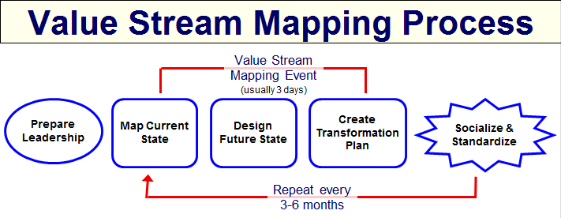
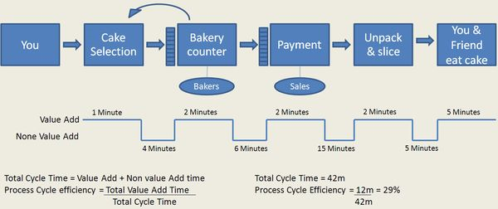
Value Stream Mapping...
http://www.systems2win.com/images/misc/vsm-process-flow-large.png
http://leadinganswers.typepad.com/.a/6a00d834527c1469e2014e8bd63793970d-600wi
https://media.licdn.com/mpr/mpr/shrinknp_800_800/p/4/005/0ab/373/1820edb.png

Slide 14
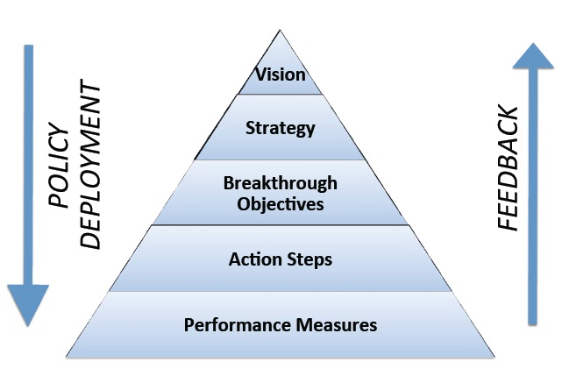
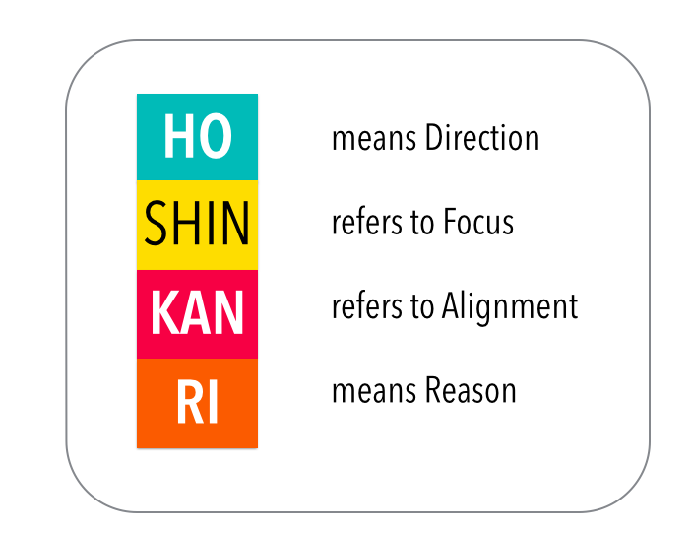
Connect strategy, tactics and
operations...
https://media.licdn.com/mpr/mpr/shrinknp_800_800/AAEAAQAAAAAAAAhrAAAAJGVkNmMxNDY4LWM4NDAtNGExZC1iMmYzLTAzZmMyYjRkZmU2Mw.png
http://missionqms.org/uploads/3/2/0/2/3202976/8577747_orig.jpg

Slide 15
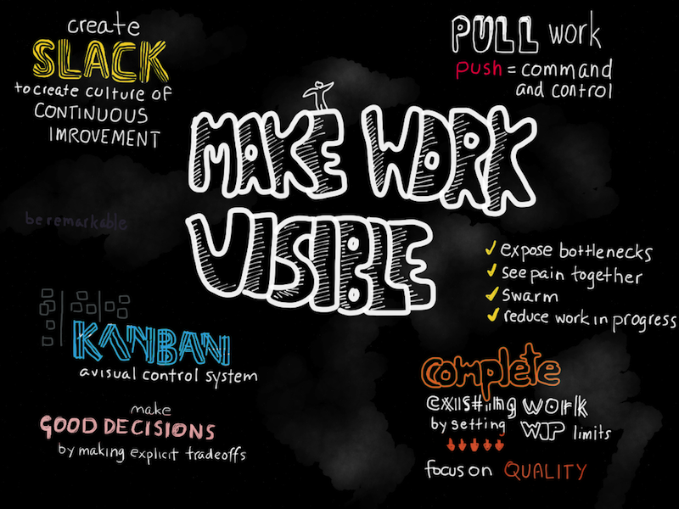
Make work visible...
http://getlit.me/wp-content/uploads/catablog/originals/make-work-visible.png

Slide 16
Authors and contributors.
Authors
Courtney Kissler, Vice President Retail Technology, Starbucks
Eric Passmore, CTO Online Publishing and Media, Microsoft
Jeff Gallimore, Partner, Excella Consulting
Jeff Robke, Senior Software Engineer – CIO Development Platform Team, IBM
Nicole Forsgren, Director, Organizational Performance & Analytics, Chef Software
Paula Thrasher, Director Digital Services, CSRA
Pauly Comtois, VP, Hearst Business Media
Raphael Garcia, Director of R&D IT, Hewlett-Packard
Rosalind Radcliffe, Distinguished Engineer, IBM
Ross Clanton, Director/Fellow DevOps, Verizon
Scott Nasello, Senior Manager – Platform & Systems Engineering, Columbia Sportswear
Scott Willson, Product Marketing Director – Release Automation, Automic
Other Contributors
Robyn Crummer-Olson, Marketing and Communications Manager, IT Revolution

